Slide 1
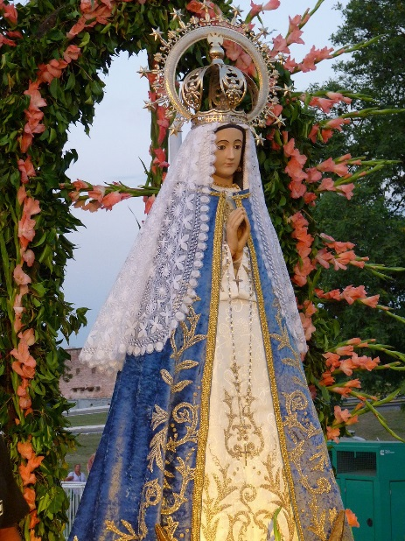
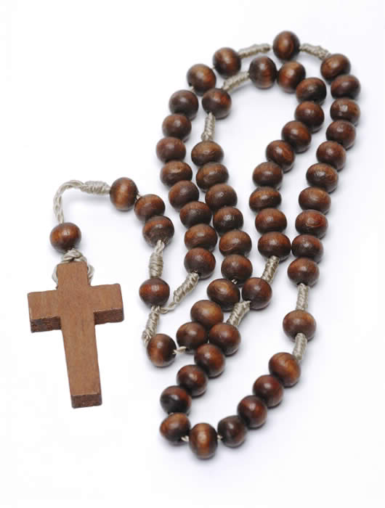
Join us for a live stream Rosary at 12 noon on 15th May, the
Feast of Our Lady of Fatima.
There will be prayers, songs and crowning of Our Lady.
All welcome at our website www.ourladyqueenof martyrs.

Slide 2
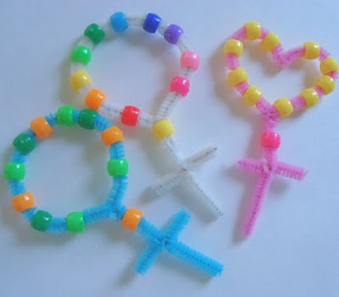
Home Activity for Little Church Children - Make your own Rosary Beads
You will need:
Pipe cleaners
Small craft beads
Scissors
Place 10 beads of your choice onto a pipe cleaner for the Hail Marys
Bring the pipe cleaner around into a circle and twist it shut
Place on one more bead for the Our Father
Cut off the extra piece and twist it around to make the cross, trim off the excess where necessary.
Please join us for a live stream Rosary on 15th May at 12 noon followed by crowning of Our Lady. All welcome at our website www.ourladyqueenof martyrs.

